Slide 1
Physics-L2 Electromagnetism
Approximative program
1) Introduction and basics
2) Electric field calculations
3) Gauss theorem
4) Electric dipoles
week | Magistral lectures
1 | Electrostatics
2 | Electrostatics
3 | Electrostatics
4 | Electrostatics
5 | Magnetostatics
6 | Magnetostatics
7 | Induction
8 | Induction
9 | Maxwell equations
10 | Maxwell equations
11 | Dielectric media
12 | Dielectric / Metallic media
13 | Metallic Media
14 | Magnetic media
Chap 1: Electrostatics
Chap 2: Magnetostatics
Chap 3: Time-dependent regime-Induction phenomena
Chap 4: Maxwell equations
Chap 5: Dielectric media and applications
Chap 6: Conducting media and applications
Chap 7: Magnetic media and applications
Institut de Physique et Ingénierie

Slide 2
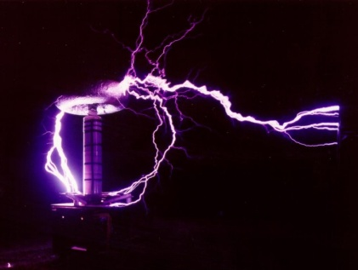
Electrostatics-L2
Introduction and Basics
1) Electrostatics devices 2) Electric charges -Ponctual charges -Continuous charges distributions
3) Electric forces and Electric fields - The Coulomb law -The electric field - Field lines 4) Electric potential and energy-Work of an electric force- Electric potential -Equipotential lines 5) Electric field created by superposition of charges -Two electric charges: Shape of the field lines-N electric charges-Continuous charges distribution 6) Symmetries of the electric field
Institut de Physique et Ingénierie

Slide 3
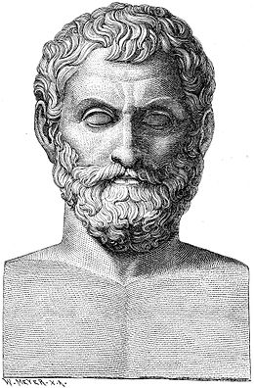
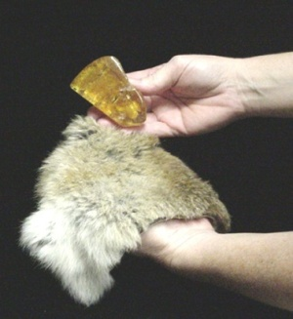
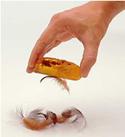
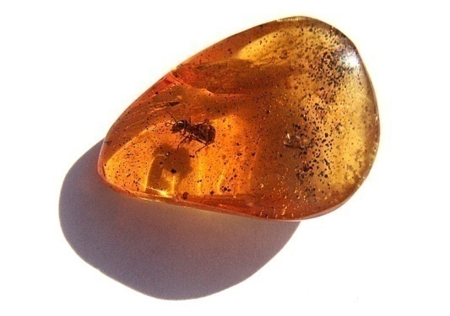
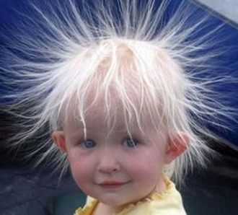
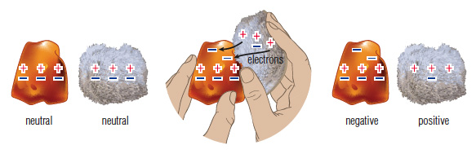
I.1) Electrostatic devices
Static Electricity
Electrisation by friction
Amber
From ancient greek:
ἤλεκτρον elektron:
Old greek
hand
Thales
625-547 BC
After rubing amber with, it can attract light objects
M
Modern explanation
Institut de Physique et Ingénierie

Slide 4
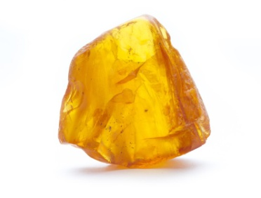

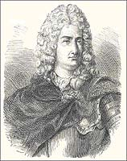
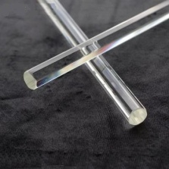
I.1) Electrostatic devices
Two types of electricity
Electricity is seen as a fluid
Resineous electricity:
obtained after friction with amber
Vitreous electricity:
obtained after friction with glass
Charles Du Fay
1698-1739
2 pendulums
rubbed with amber
REPULSION
2 pendulums
rubbed with glass
REPULSION
1 pendulum rubbed with glass and
1 pendulum rubbed with amber
ATTRACTION
Institut de Physique et Ingénierie

Slide 5
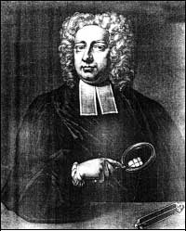
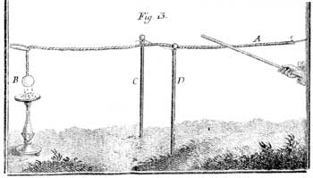
I.1) Electrostatic devices
Propagation of electricity: conductor-insulator
One can propagate electricity
existence of materials that propagate electric fluids
and others not.
Electrisation by contact
with a glass stick
Stephen Gray
1666-1736
The electric fluid propagates until the sphere because it attracts little papers
Institut de Physique et Ingénierie

Slide 6
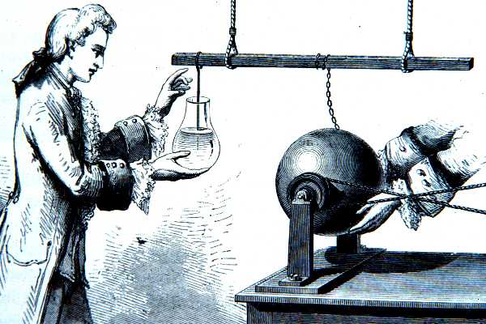
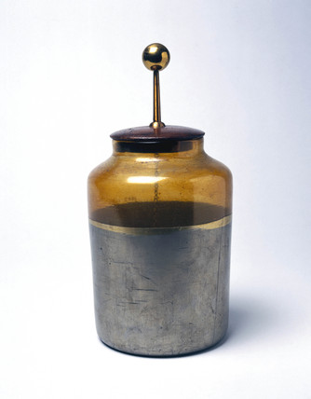
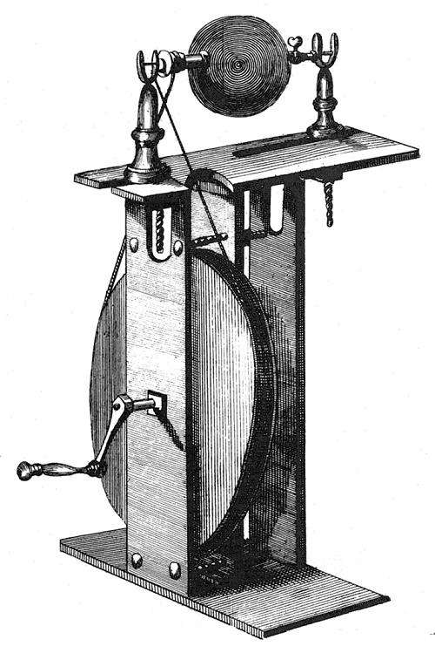
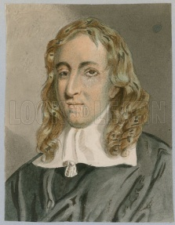
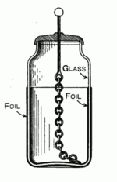
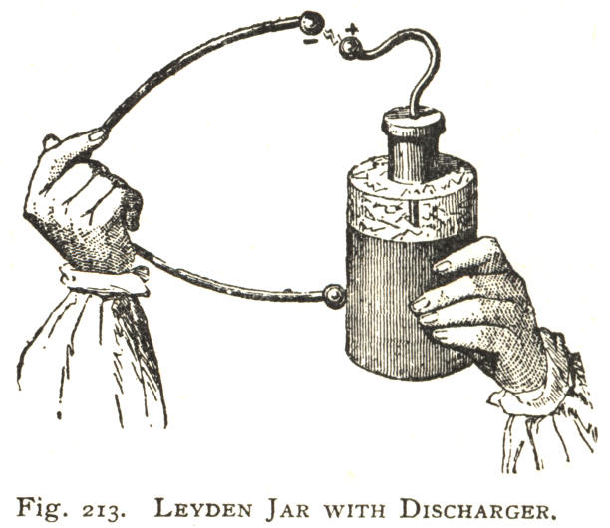
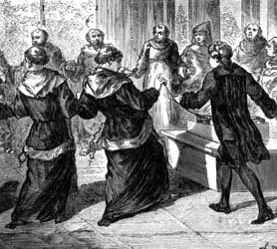
I.1) Electrostatic devices
Eletrostatic devices
1746: University of Leiden
Pieter van Musschenbroek (1692-1761)
1706
Electrisation by contact with
a rotating sulfur sphere
Leiden Jar (bottle)….first capacitor
Deliver electric discharge
Francis Hauksbee
1666-1713
Institut de Physique et Ingénierie

Slide 7
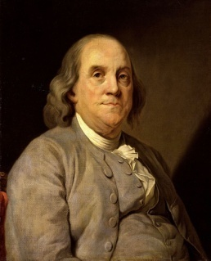

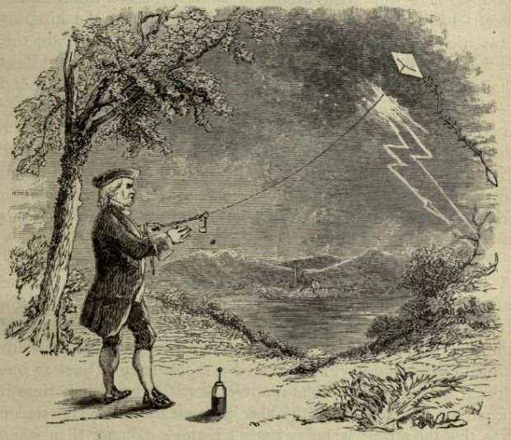
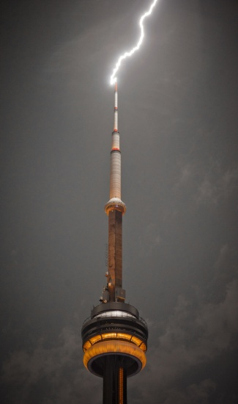
I.1) Electrostatic devices
Negative and Postives charges
Vitreous electricity and resineous electricity represent the same fluid at different pressures, the circulation of electricity put the two states at equilibrium.
Benjamin Franklin
1706-1790
- - - - - - - - -
- - - - - - - - -
+
+
+
+ + + + + + +
+ + + + + + +
Charge conservation
Phenomena acting at distance
Explanation of Leiden jar phenomena
Lightning rod
Institut de Physique et Ingénierie

Slide 8


I.1) Electrostatic devices
Interpretation of Leyden Jar
Internal
Metallic
Foil
External
Metallic
Foil
Metallic Chain propagates electric perturbation to the internal foil
+
+
+
+
-
-
-
-
-
Glass: Insulating
space between
the two foils
Possibility to close the circuit and to induce an electric discharge !!
Institut de Physique et Ingénierie

Slide 9
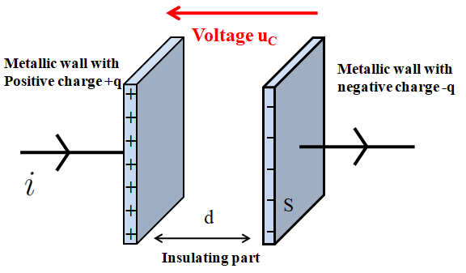
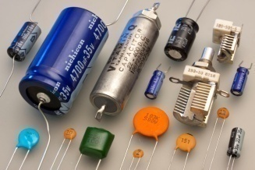
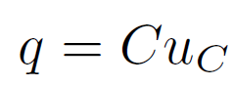
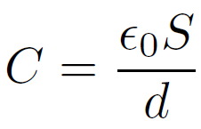
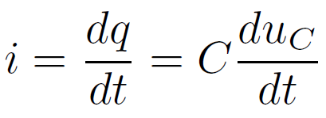
I.1) Electrostatic devices
Quick Modern description: Principle of a capacitor
Can accumulate and stock electric charges:
+
-
Electric symbol
Described by its Capacitance C (or capacity) in Farad (Coulomb/Volt):
(if insulating part is the vaccum)
C: from µF to pF
Relation between current and voltage
Institut de Physique et Ingénierie

Slide 10
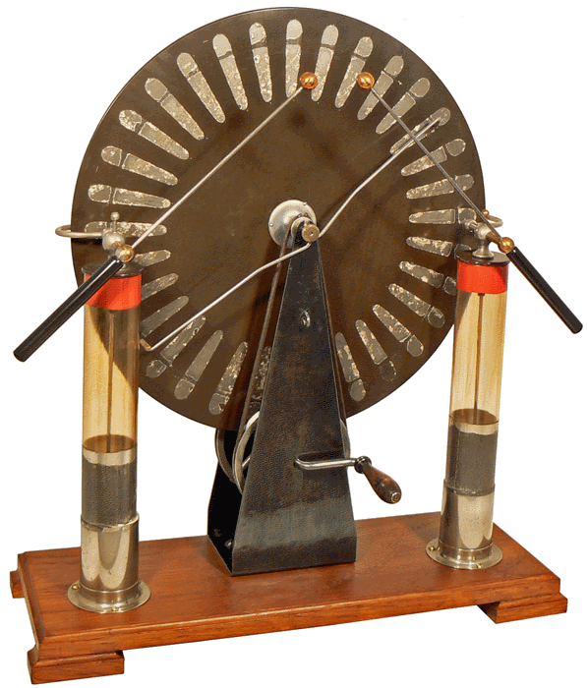
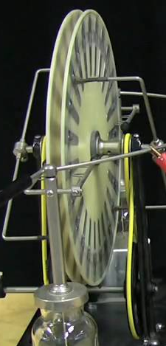
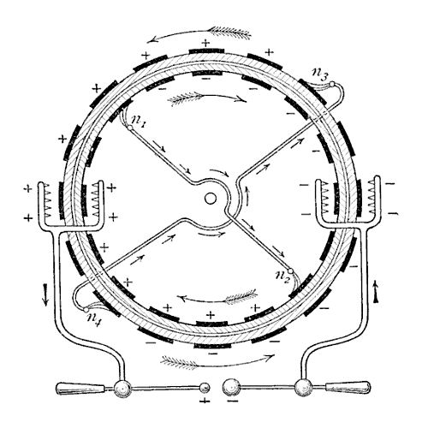
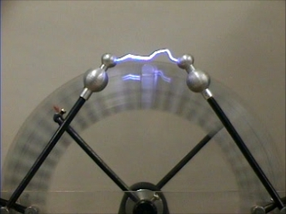
I.1) Electrostatic devices
Wimshurst Machine (1882)
Two wheels rotating in opposite direction in contact with metallic brushes.
Creation of negative charge induces apparition of a a positive charge on the other side of the brush
By the weels rotation, charges are transported and collected
When electric charges become to high: lightning
You Might watch
https://www.youtube.com/watch?v=Zilvl9tS0Og
Institut de Physique et Ingénierie

Slide 11
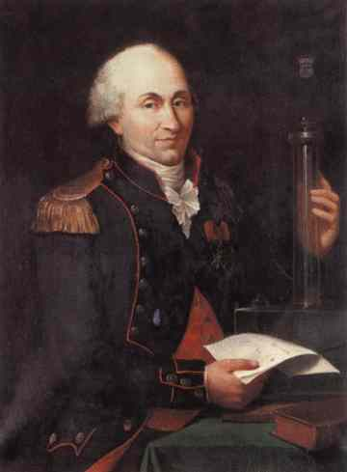
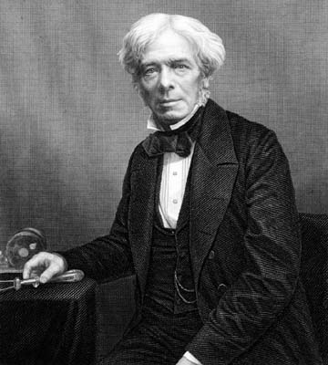
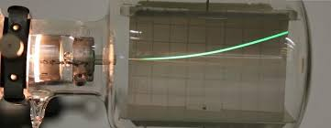
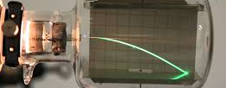
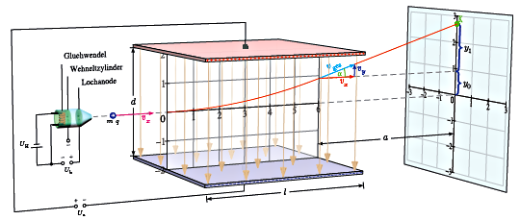


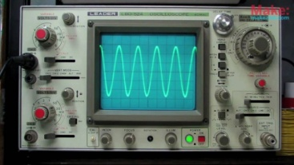
I.1) Electrostatic devices
Electric force…and Electric field…. And use to drive
electric charges !!
+ + + + + +
F
- - - - - -
Charles Coulomb
1736-1806
Michael Faraday
1791-1867
- - - - - -
F
+ + + + + +
F= q E q<0
Institut de Physique et Ingénierie

Slide 12
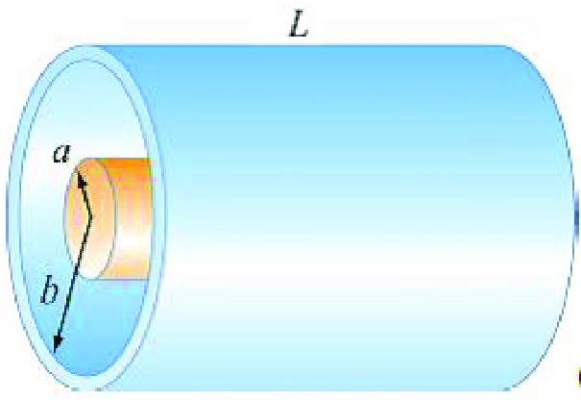

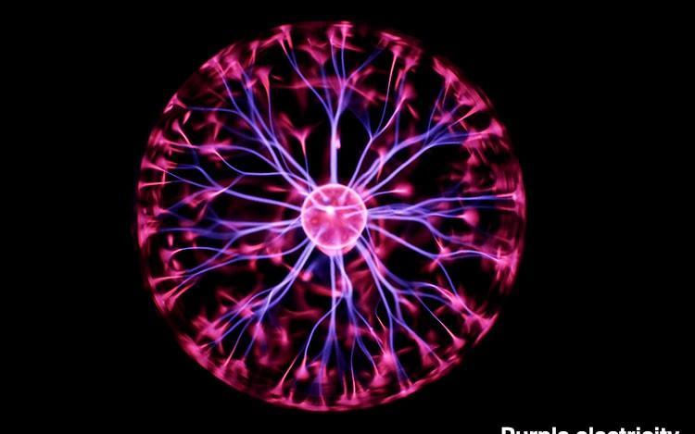
I.1) Electrostatic devices
Important question of that Electrostatic lecture….
How is the Electric field created by the electrostatic devices ????
E ??
How can we connect it to capacitance C ?? Voltage ?? Energy ??
Institut de Physique et Ingénierie

Slide 13
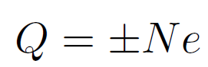
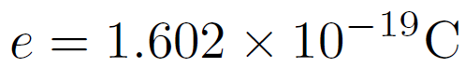

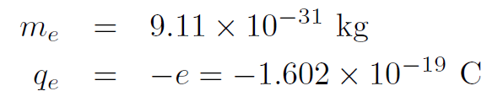
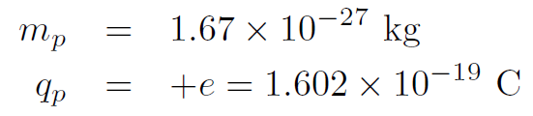
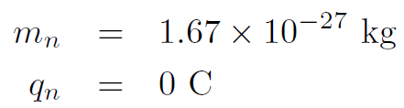
I.2) Electric charges
b) Ponctual charges
A neutral body get electrization and acquires an electric charge Q (in coulomb C)
N is an integer
e= elementary charge:
Elementary particles
Electron:
Proton:
Neutron
52 pm
≈ fm
Institut de Physique et Ingénierie

Slide 14
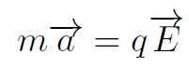
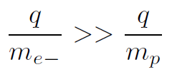
I.2) Electric charges
b) Ponctual charges
Electrons are responsible of the electrization: there are lighter than protons and also protons can not escape from the strong interaction in the nucleus.
Dynamical properties: a≈qE/m with |q_{p}|=|q_{e}|=q
Stronger for electrons
Body charged positively: lack of electrons
Body charged negatively: excess of electrons
Institut de Physique et Ingénierie

Slide 15

I.2) Electric charges
b) Ponctual charges
Electrons are responsible of the electrization: there are lighter than protons and also protons can not escape from the strong interaction in the nucleus.
Dynamical properties: a≈qE/m with |q_{p}|=|q_{e}|=q
Stronger for electrons
Body charged positively: lack of electrons
Body charged negatively: excess of electrons
In friction experiment, the electric charge Q is usually between milliCoulomb (mC) and microCoulomb (µC)
How many electrons ?
Q=10⁻³ C gives N= Q/(-e) = 6.25 10¹⁵ electrons
Q=10⁻⁶ C N=6.25 10¹² electrons
Institut de Physique et Ingénierie

Slide 16
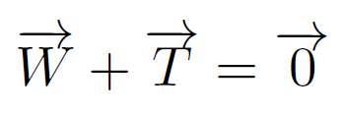
I.2) Electric charges
b) Ponctual charges
Electrostatic pendulum
Equilibrium
Institut de Physique et Ingénierie

Slide 17
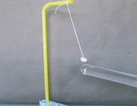
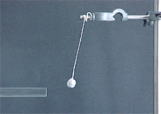
I.2) Electric charges
b) Ponctual charges
Electrostatic pendulum
Electrostatic force with a charged stick
Equilibrium
Institut de Physique et Ingénierie

Slide 18
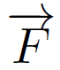



I.2) Electric charges
b) Ponctual charges
Electrostatic pendulum
Electrostatic force with a charged stick
γ
New equilibrium position
Equilibrium
Institut de Physique et Ingénierie

Slide 19

I.2) Electric charges
b) Ponctual charges
Approximation of ponctual point or charge
Usually done in mechanics
We assume the body being a material point (usually the center of mass) where all the mass stands
Can be done in electrostatics……
electrostatics of ponctual charge
Valid if charge distribution is spherical
and size of object small compared to
distance of « observation »
Institut de Physique et Ingénierie

Slide 20



I.2) Electric charges
b) Continuous charges distribution
Volume
Is made of infinitesimal volume dV=dxdydz of electric charge dq.
With ρ the (volumic) electric charge density in C/m³:
Total charge Q is obtained by
If ρ is uniform
Institut de Physique et Ingénierie

Slide 21



I.2) Electric charges
b) Continuous charges distribution
Surface
Is made of infinitesimal surface dS=dxdyof electric charge dq.
With σ the (surface) electric charge density in C/m²:
Total charge Q is obtained by
If σ is uniform
Institut de Physique et Ingénierie

Slide 22



I.2) Electric charges
b) Continuous charges distribution
Lenght
Is made of infinitesimal length dx electric charge dq.
dx
dq=λdx.
With λ the electric charge density
Total charge Q is obtained by
If λ is uniform
Institut de Physique et Ingénierie

Slide 23




I.2) Electric charges
b) Continuous charges distribution
Infinitesimal volumes and surfaces cylindric and polar coordinates
dS=rdθdz
dV=rdrdθdz
dV=drdS
=r²dr sinθdθ dφ
dS=rdθ rsinθdφ
= r²sinθdθ dφ
dS=rdθdr
Advices
Review L0: Tutorial of second semester
Mathematical tools for Physics
Institut de Physique et Ingénierie

Slide 24
Electrostatics-L2
1) Electrostatics devices 2) Electric charges -Ponctual charges -Continuous charges distributions
3) Electric forces and Electric fields
- The Coulomb law -The electric field - Field lines 4) Electric potential and energy-Work of an electric force- Electric potential -Equipotential lines 5) Electric field created by superposition of charges -Two electric charges: Shape of the field lines-N electric charges-Continuous charges distribution 6) Symmetries of the electric field
Institut de Physique et Ingénierie

Slide 25



I.3) Electric Forces and Electric fields
a) The Coulomb law
Parameters that influence the electric force
Coulomb balance: device composed with a torsion balance able
to measure weak electric forces.
Charles Coulomb
1736-1806
Repulsion of two spheres after electrisation
of neutral sphere A by charged sphere B.
Coulomb: unit of electric charge
Institut de Physique et Ingénierie

Slide 26


I.3) Electric Forces and Electric fields
a) The Coulomb law
Institut de Physique et Ingénierie

Slide 27





I.3) Electric Forces and Electric fields
a) The Coulomb law
Electric Force
Coulomb Force
Repulsion of electric charges: (q1,q2)>0 or (q1,q2)<0
r
q₁
q₂
Attraction of electric charges (q1<0, q2>0) or (q1>0 and q2<0)
r
q₁
q₂
Institut de Physique et Ingénierie

Slide 28

I.3) Electric Forces and Electric fields
a) The Coulomb law
Dielectric permittivity of vaccum
If medium is not the vaccum we use the substitution:
ε_{r} (vaccum) =1
ε_{r} (air)=1.0001
ε_{r} (water)=80
Institut de Physique et Ingénierie

Slide 29




I.3) Electric Forces and Electric fields
a) The Coulomb law
Dielectric permittivity of vaccum
If medium is not the vaccum we use the substitution:
ε_{r} (vaccum) =1
ε_{r} (air)=1.0001
ε_{r} (water)=80
Due to the polarisability of the medium (local presence of electric dipoles)
ε_{r} indicates the sensibility to the action of an electric field
Institut de Physique et Ingénierie

Slide 30

I.3) Electric Forces and Electric fields
a) The Coulomb law
Exercises for tutorials
Institut de Physique et Ingénierie

Slide 31
I.3) Electric Forces and Electric fields
a) The Electric field
WHAT IS THE ELECTRIC FIELD ???
q₀
P
We consider an electric charge q0 at point P
Institut de Physique et Ingénierie

Slide 32

I.3) Electric Forces and Electric fields
a) The Electric field
WHAT IS THE ELECTRIC FIELD ???
q₀
P
We consider an electric charge q0 at point P
q₁
M
Then we put a charge q1 at M at a distance r from P, the force felt by q1 due to q0 is
Institut de Physique et Ingénierie

Slide 33
I.3) Electric Forces and Electric fields
a) The Electric field
WHAT IS THE ELECTRIC FIELD ???
q₀
P
We consider an electric charge q0 at point P
We remove charge q1
Institut de Physique et Ingénierie

Slide 34

I.3) Electric Forces and Electric fields
a) The Electric field
WHAT IS THE ELECTRIC FIELD ???
q₀
P
We consider an electric charge q0 at point P
q₂
M
Then we put a charge q2 at M at a distance r from P, the force felt by q2 due to q0 is
Institut de Physique et Ingénierie

Slide 35
I.3) Electric Forces and Electric fields
a) The Electric field
WHAT IS THE ELECTRIC FIELD ???
q₀
P
We consider an electric charge q0 at point P
We remove charge q2
Institut de Physique et Ingénierie

Slide 36

I.3) Electric Forces and Electric fields
a) The Electric field
WHAT IS THE ELECTRIC FIELD ???
q₀
P
We consider an electric charge q0 at point P
q_{N}
M
Then we put a charge q3 at M at a distance r from P, we look the force felt by q3 due to q0.
We remove charge q3…………….until qN-1 and we remove qN-1.
Then we put a charge qN at M at a distance r from P, we the force felt by qN due to q0 is
Institut de Physique et Ingénierie

Slide 37

I.3) Electric Forces and Electric fields
a) The Electric field
WHAT IS THE ELECTRIC FIELD ???
q₀
P
We consider an electric charge q0 at point P
What is the invariant in that stupid experiment ?
M
It exist one quantity induced by the existence of q0 that modifies the space-properties
Institut de Physique et Ingénierie

Slide 38







I.3) Electric Forces and Electric fields
Electric field
q₁>0
q₂<0
r
Force felt by particule 2 due to electric field 1
q₁>0
q₂<0
Institut de Physique et Ingénierie

Slide 39


I.3) Electric Forces and Electric fields
Electric field
q₁>0
q₂<0
r
Force felt by particule 2 due to electric field 1
q₁>0
q₂<0
Institut de Physique et Ingénierie

Slide 40

I.3) Electric Forces and Electric fields
c) Fields line
Electric field Lines
In the planes…
q₁>0
q₂<0
r
r
Institut de Physique et Ingénierie

Slide 41
Electrostatics-L2
1) Electrostatics devices 2) Electric charges -Ponctual charges -Continuous charges distributions
3) Electric forces and Electric fields - The Coulomb law -The electric field - Field lines
4) Electric potential and energy-
Work of an electric force- Electric potential -Equipotential lines 5) Electric field created by superposition of charges -Two electric charges: Shape of the field lines-N electric charges-Continuous charges distribution 6) Symmetries of the electric field
Institut de Physique et Ingénierie

Slide 42











I.4) Electric potential and energy
Work of an electric force
We move an electric charge q in a region where lives an electric field E(M)
(q)
Elementary work δW over distance dl (between M and M’)
Institut de Physique et Ingénierie

Slide 43

I.4) Electric potential and energy
Work of an electric force
We move an electric charge q in a region where lives an electric field E(M)
(q)
Elementary work δW over distance dl (between M and M’)
Total work W over path AB
Circulation of electric field along path AB
Institut de Physique et Ingénierie

Slide 44

I.4) Electric potential and energy
Relation with the energy
Conservation of energy
Institut de Physique et Ingénierie

Slide 45


I.4) Electric potential and energy
Relation with the energy
Conservation of energy
The total energy change is zero and the change of kinetic energy is the opposite of the change of potential energy
Institut de Physique et Ingénierie

Slide 46



I.4) Electric potential and energy
Relation with the energy
Conservation of energy
The total energy change is zero and the change of kinetic energy is the opposite of the change of potential energy
We know from kinetic energy theorem that the work of the system is equal to the change of kinetic energy
The work is the opposite of the change of
Potential energy
Institut de Physique et Ingénierie

Slide 47

I.4) Electric potential and energy
Connection between electric field and potential energy
And with
Institut de Physique et Ingénierie

Slide 48


I.4) Electric potential and energy
Connection between electric field and potential energy
And with
We can connect the potential energy to a quantity called electric potential
Institut de Physique et Ingénierie

Slide 49

I.4) Electric potential and energy
Connection between electric field and potential energy
And with
We can connect the potential energy to a quantity called electric potential
Defined as :
Institut de Physique et Ingénierie

Slide 50





I.4) Electric potential and energy
Example:
Lets consider an electric field created by a charge q0.
(q)
ZOOM
Institut de Physique et Ingénierie

Slide 51

I.4) Electric potential and energy
Example:
Lets consider an electric field created by a charge q0.
(q)
ZOOM
zero
Institut de Physique et Ingénierie

Slide 52


I.4) Electric potential and energy
Hello !! Potential created by an electric charge q0
Unit: Volt
Usually we take the following convention to find the value of the constant:
At infinity, the effect of potential should be zero.
However, in some case it could be different. A potential with non-zero value can be imposed at a given distance (for instance with capacitors)
Institut de Physique et Ingénierie

Slide 53



I.4) Electric potential and energy
Relation between Electric field and Electric Potential
But a total differential function dV can be written
With the help of the gradient operator
Institut de Physique et Ingénierie

Slide 54




I.4) Electric potential and energy
Relation between Electric field and Electric Potential
But a total differential function dV can be written
With the help of the gradient operator
Finaly
Electric Potential
Electric Field
Institut de Physique et Ingénierie

Slide 55


I.4) Electric potential and energy
c) Equipotential lines
Equipotential lines
(electric potential)
V₂ < V₁
V₁
Space region where the potential V is constant
Field lines
(electric field)
Field Lines are perpendicular to equipotential lines
Institut de Physique et Ingénierie

Slide 56


I.4) Electric potential and energy
c) Equipotential lines
Topography of Electric potential V created by a ponctual charge
q>0
q<0
Institut de Physique et Ingénierie

Slide 57
Electrostatics-L2
1) Electrostatics devices 2) Electric charges -Ponctual charges -Continuous charges distributions
3) Electric forces and Electric fields - The Coulomb law -The electric field - Field lines
4) Electric potential and energy- Work of an electric force- Electric potential -Equipotential lines
5) Electric field created by superposition of charges –
Two electric charges: Shape of the field lines-N electric charges-Continuous charges distribution 6) Symmetries of the electric field
Institut de Physique et Ingénierie

Slide 58

I.5) Electric field created by superposition of charges
a)Two electric charges
Superposition: electric field created by two charges
q₁>0
q₂<0
r
r
Institut de Physique et Ingénierie

Slide 59





I.5) Electric field created by superposition of charges
a)Two electric charges
Superposition: electric field created by two charges
2
q₁>0
q₂<0
r
r
Institut de Physique et Ingénierie

Slide 60

I.5) Electric field created by superposition of charges
a)Two electric charges
Electric field created by two charges
Field lines
q₁ and q₂ equal and <0
q₁ and q₂ opposite
Institut de Physique et Ingénierie

Slide 61


I.5) Electric field created by superposition of charges
a)Two electric charges
Electric field created by two charges
Field lines
Equipotential lines
q₁ and q₂ equal and <0
q₁ and q₂ opposite
Institut de Physique et Ingénierie

Slide 62


I.5) Electric field created by superposition of charges
a)Two electric charges
Electric field created by two charges
Topography of Electric potential V
!! (q>0 on map….)
Should go down !!
Institut de Physique et Ingénierie

Slide 63











I.5) Electric field created by superposition of charges
a)Two electric charges
Challenging exercise to do at home
Potential at point M due to q₁ and q₂
With
Institut de Physique et Ingénierie

Slide 64

I.5) Electric field created by superposition of charges
a)Two electric charges
Challenging exercise to do at home
Equation for equipotential :
Institut de Physique et Ingénierie

Slide 65

I.5) Electric field created by superposition of charges
a)Two electric charges
Challenging exercise to do at home
V=0
Equation for equipotential :
-5d/6
We put q₁=-q and q₂=+2q: Show that the points that satisfy the equipotential V=0
Belong to a circle of radius R=2d/3 whose center is (x_{c}=-5d/6; y_{c}=0)
Equation of a circle
Institut de Physique et Ingénierie

Slide 66




I.5) Electric field created by superposition of charges
b) N electric charges
Superposition of N electric charges
If it is true for 2 it is true for N, no ??*
M
* In reality, the interaction between the N charges modify the total electric field
(out of program obviously and probably of your life which of course we do not wish)
Institut de Physique et Ingénierie

Slide 67




I.5) Electric field created by superposition of charges
b) N electric charges
So, it is a funny game to look to the electric field lines created by many charges
Institut de Physique et Ingénierie

Slide 68


I.5) Electric field created by superposition of charges
b) N electric charges
In tutorial….
Basics geometric figures and….funny field lines
-q
-q
Institut de Physique et Ingénierie

Slide 69



I.5) Electric field created by superposition of charges
c) Continuous charges distribution
Calculation of the total field produced by charge distribution
Order of magnitude of distance between charge
distance from charge center of mass
Institut de Physique et Ingénierie

Slide 70
I.5) Electric field created by superposition of charges
c) Continuous charges distribution
Calculation of the total field produced by charge distribution
Order of magnitude of distance between charge
distance from charge center of mass
If r >> d we can assume a continuous charge distribution
Institut de Physique et Ingénierie

Slide 71







I.5) Electric field created by superposition of charges
c) Continuous charges distribution
Calculation of the total field produced by charge distribution
1. We consider first elementary field produced by element dx of charge dq
M
r
2. Total field is the sum of the field created by all elements dqi
M
r_{i}
Can be written as an integral form
Institut de Physique et Ingénierie

Slide 72


I.5) Electric field created by superposition of charges
c) Continuous charges distribution
ELECTRIC FIELD
For a lineic distribution we have an integral
r
M
For a surface distribution we have a double integral
r
For a volumic distribution we have a triple integral
Institut de Physique et Ingénierie

Slide 73
I.5) Electric field created by superposition of charges
c) Continuous charges distribution
ELECTRIC POTENTIAL
For a lineic distribution we have an integral
r
M
V
For a surface distribution we have a double integral
r
V
For a volumic distribution we have a triple integral
V
Institut de Physique et Ingénierie

Slide 74


I.5) Electric field created by superposition of charges
c) Continuous charges distribution
We will see during lecture the electric field and potential of some distributions
wire (1D) crown (2D) disc (2D) plan (2D) cylinder (3D) sphere (3D)
Method(s)
First calculation of electric field
and then electric potential by integration
OR
2) First calculation of electric potential
and then electric field by derivation
Institut de Physique et Ingénierie

Slide 75







I.5) Electric field created by superposition of charges
c) Continuous charges distribution
Some Goal(s) of the Electrostatics chapter:
Given a electric charge distribution, how is distributed the electric field ?
Example 1: The plane or cylindrical capacitor
Example 2: The electrostatics
of Earth….
2 plans….
1 sphere…
2 coaxial cylinders
Institut de Physique et Ingénierie

Slide 76


I.5) Energy of a superposition of charges
The potential energy of two electric charges is given by
q₁
q₂
r
2
1
Be careful, mistake in first version (between 1 and 2)
Institut de Physique et Ingénierie

Slide 77

I.5) Energy of a superposition of charges
The potential energy of N electric charges…..a lot of interactions
Let’s calculate the quantity…
Institut de Physique et Ingénierie

Slide 78
I.5) Energy of a superposition of charges
The potential energy of N electric charges…..a lot of interactions
Let’s calculate the quantity…
SUM
Because q_{i}V_{j}=q_{j}V_{i}
Each interaction is counted twice !
Institut de Physique et Ingénierie

Slide 79

I.5) Energy of a superposition of charges
The potential energy of N electric charges…..a lot of interactions
Let’s calculate the quantity…
SUM
Because q_{i}V_{j}=q_{j}V_{i}
Each interaction is counted twice !
Institut de Physique et Ingénierie

Slide 80
Electrostatics-L2
1) Electrostatics devices 2) Electric charges -Ponctual charges -Continuous charges distributions
3) Electric forces and Electric fields - The Coulomb law -The electric field - Field lines
4) Electric potential and energy- Work of an electric force- Electric potential -Equipotential lines
5) Electric field created by superposition of charges –
Two electric charges: Shape of the field lines-N electric charges-Continuous charges distribution
6) Symmetries of the electric field
Institut de Physique et Ingénierie

Slide 81


I.6) Symmetries of the electric field
Symmetry of the electric charge distribution
+
+
PLAN OF SYMMETRY
PLAN OF ANTI- SYMMETRY
Institut de Physique et Ingénierie

Slide 82
I.6) Symmetries of the electric field
Symmetry of the electric charge distribution
+
+
PLAN OF SYMMETRY
PLAN OF ANTI- SYMMETRY
An electric field created in a point o f the plane of symmetry belongs to the plane
An electric field created in a point of the plane of anti- symmetry is perpendicular to the plane
Institut de Physique et Ingénierie

Slide 83
I.6) Symmetries of the electric field
Symmetry of the electric charge distribution
+
dθ
+
+
z+dz
+
+
+
+
+
+
+
θ
+
+
+
+
z
+
+
+
+
+
+
+
+
+
SYMMETRY OF TRANSLATION
ρ(x,y,z)=ρ(x,y)
SYMMETRY OF ROTATION
ρ(r,θ) =ρ(r)
ρ(z+dz) =ρ(z)
ρ(θ+dθ) =ρ(θ)
Institut de Physique et Ingénierie

Slide 84
I.6) Symmetries of the electric field
Cylindrical symmetry
Finite cylinder
Plan in the middle of the cylinder
Any plan that goes through the center of base
Institut de Physique et Ingénierie

Slide 85
I.6) Symmetries of the electric field
Cylindrical symmetry
An electric field created in a point o f the plane of symmetry belongs to the plane
Institut de Physique et Ingénierie

Slide 86
I.6) Symmetries of the electric field
Cylindrical symmetry
Infinite cylinder
…..
Infinity of middle of cylinder
F(r,θ,z)=F(r)
Institut de Physique et Ingénierie

Slide 87
I.6) Symmetries of the electric field
Spherical symmetry
F(r,θ,φ)=F(r)
Any axis that goes through the center
Institut de Physique et Ingénierie

Slide 88
Physics-L2 Electromagnetism
Approximative program
1) Introduction and basics
2) Electric field calculations
3) Gauss theorem
4) Electric dipoles
week | Magistral lectures
1 | Electrostatics
2 | Electrostatics
3 | Electrostatics
4 | Electrostatics
5 | Magnetostatics
6 | Magnetostatics
7 | Induction
8 | Induction
9 | Maxwell equations
10 | Maxwell equations
11 | Dielectric media
12 | Dielectric / Metallic media
13 | Metallic Media
14 | Magnetic media
Chap 1: Electrostatics
Chap 2: Magnetostatics
Chap 3: Time-dependent regime-Induction phenomena
Chap 4: Maxwell equations
Chap 5: Dielectric media and applications
Chap 6: Conducting media and applications
Chap 7: Magnetic media and applications
Institut de Physique et Ingénierie

Slide 89
Electrostatics-L2
2) Electric field calculations
Electric field created by a charged electric wire-
Calculation of the electric field- Limit case of the infinite wire.-Analysis in terms of field lines
2) Some examples of 2D electric charged structures-Electric field and electric potential created by a crown and a disc- Limit case of the infinite charged plane-Analysis in terms of field lines
3) Application to the plane capacitor- Electric field and electric potential-Capacitance and energy.
Institut de Physique et Ingénierie

Slide 90

II.1) Electric field created by a charged electric wire
Exercise 1: Electric field created by a charged wire
Institut de Physique et Ingénierie

Slide 91



II.1) Electric field created by a charged electric wire
Application in Biology-Biophysics
0.34 nm
Phosphorus atoms with negative charge
-e at altitude of each base pair
Institut de Physique et Ingénierie

Slide 92
II.1) Electric field created by a charged electric wire
Application in Biology-Biophysics
0.34 nm
Phosphorus atoms with negative charge
-e at altitude of each base pair
Modelisation with Physics
-e
-e
-2e
-e
λ=-2e/d
= -2. 1,6 10⁻¹⁹/ 3.4 10⁻¹⁰
= 1.06 10⁻⁹ C/m
d=0.34 nm
-2e
-e
-2e
-e
-2e
-e
-e
-2e
Institut de Physique et Ingénierie

Slide 93





II.1) Electric field created by a charged electric wire
After Calculations using integration
Expression of the electric field in the plane cutting the middle of the stick of size 2a:
The electric field vector is perpendicular to the axis given by the wire
Limit case of infinite wire (with 2a >> z):
It exists an infinity of symmetry planes
The electric field is perpendicular to the wire everywhere
Institut de Physique et Ingénierie

Slide 94



II.1) Electric field created by a charged electric wire
Interpretation in terms of Field lines !!
ZOOM on
field lines
created by
two charges
Orientation of
Electric field vector is
parallel to the field lines
Institut de Physique et Ingénierie

Slide 95
II.1) Electric field created by a charged electric wire
Interpretation in terms of Field lines !!
ZOOM on
field lines
created by
two charges
Orientation of
Electric field vector is
parallel to the field lines
Institut de Physique et Ingénierie

Slide 96


II.1) Electric field created by a charged electric wire
Summary of Electric Field Lines
Finite wire
Infinite wire
1/z dependence
Institut de Physique et Ingénierie

Slide 97


II.1) Electric field created by a charged electric wire
About the electric potential at distance z in the middle of the wire: two methods of calculation
Finite wire
1) By integrating the electric field
with
and dr =dz
2) By calculating the potential created by all small elements
Both cases are not easy to achieve. We give the results for your information….
Institut de Physique et Ingénierie

Slide 98





II.1) Electric field created by a charged electric wire
Easier for infinite wire
The integration of electric field is easy
But the result is problematic because we obtain ln z with z a distance and what is inside the ln should be a number….
So we define a given z₀ for which the potential is zero V(z₀)=0
We can find a value for the constant and we obtain finally for V(z)
Institut de Physique et Ingénierie

Slide 99
Electrostatics-L2
2) Electric field calculations
Electric field created by a charged electric wire-
Calculation of the electric field- Limit case of the infinite wire.-Analysis in terms of field lines
2) Some examples of 2D electric charged structures-
Electric field and electric potential created by a crown and a disc- Limit case of the infinite charged plane-Analysis in terms of field lines
3) Application to the plane capacitor- Electric field and electric potential-Capacitance and energy.
Institut de Physique et Ingénierie

Slide 100

II.2) Electric field created by 2D electric charged structure
Institut de Physique et Ingénierie

Slide 101



II.2) Electric field created by 2D electric charged structure
Steps of calculations
Crown
R₁, internal radius
R₂ external radius
Disc
R₁ → 0
Infinite Plan
R₁ → 0
R₂ → ∞
∞
↑
→∞
Institut de Physique et Ingénierie

Slide 102

II.2) Electric field created by 2D electric charged structure
Interests
Example 1: The plane capacitor
Will be seen in details….
2 plans….
Example 2: Biological membrane
Membrane is made of phospholipids that can be neutral or charged negatively. Assuming 1 over 10 molecules is charged and its surface is
S=60 Angström squared (10⁻¹⁰ m)² we can estimate the electric surface density (2 membranes)
σ=Q/S = -2e/(10 S) = -2*1.6 10⁻¹⁹ /10 / 60 10⁻²⁰
=-32/600≈ -0.053 C/m²
Institut de Physique et Ingénierie

Slide 103


II.2) Electric field created by 2D electric charged structure
Results in the case of infinite plane
+++++++
Electric field is constant and
perpendicular to the plane
Institut de Physique et Ingénierie

Slide 104
II.2) Electric field created by 2D electric charged structure
Interpretation in terms of field lines:
plane is an infinite sum of infinte wires
ZOOM on two nearest wire s
+++++++
+
+
+
+
+
+
+
+
+
+
Institut de Physique et Ingénierie

Slide 105
II.2) Electric field created by 2D electric charged structure
Interpretation in terms of field lines:
plane is an infinite sum of wires
Vision from the top
to the bottom (3 wires)
+
+
+
ZOOM on two nearest wires
+++++++
+
+
+
+
+
+
+
+
+
+
Institut de Physique et Ingénierie

Slide 106
II.2) Electric field created by 2D electric charged structure
Interpretation in terms of field lines:
plane is an infinite sum of wires
Vision from the top
to the bottom (3 wires)
+
+
+
ZOOM on two nearest wires
+++++++
+
+
+
+
+
+
+
+
+
+
+
+
+
Institut de Physique et Ingénierie

Slide 107
Electrostatics-L2
2) Electric field calculations
Electric field created by a charged electric wire-
Calculation of the electric field- Limit case of the infinite wire.-Analysis in terms of field lines
2) Some examples of 2D electric charged structures-
Electric field and electric potential created by a crown and a disc- Limit case of the infinite charged plane-Analysis in terms of field lines
3) Application to the plane capacitor- Electric field and electric potential-Capacitance and energy.
Institut de Physique et Ingénierie

Slide 108
II.3) Application to plane capacitor
Application to plane capacitor
Plane Capacitor can be….
….the sum of two charged and
opposites planes separated from distance d
Described by its Capacitance C (or capacity) in Farad (Coulomb/Volt):
(if insulating part is the vaccum)
C: from µF to pF
(cylindrical and plane
Capacitors)
Relation between current and voltage
Institut de Physique et Ingénierie

Slide 109
II.3) Application to plane capacitor
Electric field
position z=-d/2
+++++++
z=-d/2
E
-E
Institut de Physique et Ingénierie

Slide 110
II.3) Application to plane capacitor
Electric field
position z=-d/2
+++++++
z=-d/2
E
-E
position z=d/2
-------
z=d/2
E
-E
Institut de Physique et Ingénierie

Slide 111
II.3) Application to plane capacitor
We superpose the two configurations
Electric field
+++++++
z=-d/2
z=d/2
-------
E
-E
outside
cancel
outside
cancel
Inside:
addition
Institut de Physique et Ingénierie

Slide 112
II.3) Application to plane capacitor
We superpose the two configurations
Electric field
z=-d/2
z=d/2
2E
+++++++
-------
E
0
0
-E
outside
cancel
outside
cancel
Inside:
addition
We obtain a capacitor:
electric field is only INSIDE !
Institut de Physique et Ingénierie

Slide 113

II.3.c) Electron dynamics in a constant and uniform electric field
Two charged plates: creation of uniform electric field
Device used to accelerate and/or
deviate charged particle
Institut de Physique et Ingénierie

Slide 114






II.3.c) Electron dynamics in a constant and uniform electric field
Motion equation with electric field along positive x axis
(contrary than previous slide where electric field is along y axis)
Accelerates (and deviates) charge particles
q>0
Accelerated rect motion (1D)
q>0
Accelerated parabolic motion (2D)
Institut de Physique et Ingénierie

Slide 115

Karl Friedrich Gauss 1777-1865

Slide 116
Electrostatics-L2
1) Need of Geometry-Notion of vector flux-Solid Angle 2) Statement of Gauss theorem
3) Direct applications-Electric fields created by an infinite wire and by an infinite plane-by an empty and full charged cylinder-by an Empty and full sphere 4) Examples:- Cylindrical Capacitors 5) Earth as a Capacitor
Institut de Physique et Ingénierie

Slide 117




III.1a) Notion of vector flux
V
V . dS : maximum
Flux of V through surface dS is maximum
Institut de Physique et Ingénierie

Slide 118
III.1a) Notion of vector flux
V
V . dS reduced
Flux of V through surface dS is reduced
Institut de Physique et Ingénierie

Slide 119
III.1a) Notion of vector flux
V
V . dS = 0
Flux of V through surface dS is zero !!
Institut de Physique et Ingénierie

Slide 120

III.1b) Solid angle under which is seen a closed surface
Point O is outisde the closed surface
Point O is inside the closed surface
dS₂
dS₂
n₁
n₂
O
dS₁
dS₁
We assume spherical elementary surface for
each dS
dΩ₁= u_{r}.dS₁ dΩ₂= u_{r}. dS₂
r₁² r₂²
dΩ₁ =- dΩ₂ solid angles are opposite
∫∫dΩ=0 total contribution is zero.
dS=r²sinθdθ dφ
_{π 2π}
∫∫dΩ= ∫∫ u_{r}.dS = ∫₀sinθdθ ∫₀dφ = 4 π
r²
The solid angle for all space is 4 π
Institut de Physique et Ingénierie

Slide 121


III.2) Gauss theorem
The flux of electric field crossing a closed surface is equal to the electric charge inside the volume delimited by the closed surface divided by espilon0
dS
r₂
Volume
Delimited by a
closed surface
Institut de Physique et Ingénierie

Slide 122

III.2) Gauss theorem
Tutorial 2: Exercises 1 and 2 have been done in Lecture
Institut de Physique et Ingénierie

Slide 123

III.2) Gauss theorem
Tutorial 2: Exercises 3 and 4 during the two next Tutorial sessions
Institut de Physique et Ingénierie

Slide 124







III.3a) Electric field created by an infinite cylinder charged in volume
Cylinder charged in volume
Institut de Physique et Ingénierie

Slide 125



III.3a) Electric field created by an infinite cylinder charged in volume
Cylinder charged in surface
Institut de Physique et Ingénierie

Slide 126
III.3a) Electric field created by an infinite cylinder charged in volume
Cylinder charged in volume
Cylinder charged in surface
Institut de Physique et Ingénierie

Slide 127








III.3a) Electric field created by an infinite cylinder charged in volume
Sphere charged in volume
R
Institut de Physique et Ingénierie

Slide 128


III.3a) Electric field created by an infinite cylinder charged in volume
Sphere charged in surface
R
Institut de Physique et Ingénierie

Slide 129
III.3a) Electric field created by an infinite cylinder charged in volume
Sphere charged in volume
R
Sphere charged in surface
R
Institut de Physique et Ingénierie

Slide 130



III.4) Cylindric Capacitor
Potential V₁ on internal cylinder
(radius R1)
Potential V₂ on external cylinder
(radius R2)
Institut de Physique et Ingénierie

Slide 131




III.4) Cylindric Capacitor
We assume cylinder charged on the surface with a negligible thickness
h
z
Difference of Potential ∆V= V₁ –V₂ between
the internal cylinder and the external cylinder
V₁
V₂
z
R₁
R₂
h=2cm
R2= 1 cm C=1.6 10⁻¹² F
R1= 5 mm
Institut de Physique et Ingénierie

Slide 132

III.5) Earth as a capacitor
Ionisation processess at an altitude of 80 km from Earth surface
Pressure ≈ 2 Pascal. UV radiation collide with molecules
Electrons are ejected into space and positive ions remain
UV
Ionosphere
IONOSPHERE
Institut de Physique et Ingénierie

Slide 133









III.5) Earth as a capacitor
Ionosphere
Electric Field and potential created by a sphere
Potential difference between ground and ionosphere
Earth capacitance
Similar to
RT= 6371 km
h =80 km C= 56,4 mF
value of Earth capacity !!
Institut de Physique et Ingénierie

Slide 134
Electrostatics-L2
1) Electrostatic dipole- Potential and electric fields in the dipolar approximation- Molecules -Dipole-dipole interactions 2) Electrostatics of conductors
Institut de Physique et Ingénierie

Slide 135

IV.1.a) Potential and electric fields in the dipolar approximation
y
M(x,y)
r
θ
N
-
O
P
+
x
-q at
-a/2
+q at
a/2
Institut de Physique et Ingénierie

Slide 136
IV.1.a) Potential and electric fields in the dipolar approximation
y
M(x,y)
r
θ
N
-
O
P
+
x
-q at
-a/2
+q at
a/2
Institut de Physique et Ingénierie

Slide 137





IV.1.a) Potential and electric fields in the dipolar approximation
Institut de Physique et Ingénierie

Slide 138


IV.1.a) Potential and electric fields in the dipolar approximation
Working within the dipolar approximation: r>>a for which the distance of observation is large compared to the size of the dipole.
We will obtain in polar coordinates
Dipolar moment: p=qNP
Institut de Physique et Ingénierie

Slide 139

IV.1.a) Potential and electric fields in the dipolar approximation
Calculation of the electric field
Using polar coordinates
Institut de Physique et Ingénierie

Slide 140

IV.1.a) Potential and electric fields in the dipolar approximation
Field Lines
Normal Dipole
Dipole in the dipolar approximation: r>>a
r
a
Not valid with approximated formula close to r≈a
Results obtained from potential
Institut de Physique et Ingénierie

Slide 141



IV.1.b) Molecules
Water
Hydrogen Chloride
Carbone dioxide
Even in neutral molecules
Non homogeneous repartition of electric
Charges due to electronegativity
Institut de Physique et Ingénierie

Slide 142

IV.1.b) Molecules
Institut de Physique et Ingénierie

Slide 143



IV.1.b) Molecules
Water
Hydrogen Chloride
Existence of electrostatic dipoles
Carbone dioxide
N
-
p
P
+
4
Defined from N to P in Physics
BUT
Defined from P to N in Chemistry…..
N
-
µ
P
+
Institut de Physique et Ingénierie

Slide 144
IV.1.b) Molecules
Hydrogen Chloride
Carbone dioxide
4
p=0
CO2 has no dipolar moment
Water
Institut de Physique et Ingénierie

Slide 145






IV.1.b) Molecules
Deviation of a water flow by a rubbed object
+
+
+
+
-
+
+
+
Institut de Physique et Ingénierie

Slide 146




SMALL ELECTRIC FIELD
NO ELECTRIC FIELD
θ
U = -p E cos θ
LARGE ELECTRIC FIELD
Dipole rotate in the direction of the field
Torque of a force
Anti-parallel
Energy MAX
Unstable
pE
Energy:
Parallel
Energy MIN
Stable
-pE
Institut de Physique et Ingénierie

Slide 147



POLARIZATION VECTOR is volumic contribution
of all dipoles:
Its amplitude is proportional to the applied electric field
Dielectric succeptibility: χ depends on material
Total electric field is:
Dielectric permitivity ε_{r}
Institut de Physique et Ingénierie

Slide 148


IV.1.c) Dipole-Dipole interaction
Interaction between dipoles
Institut de Physique et Ingénierie

Slide 149
IV.1.c) Dipole-Dipole interaction
Interaction between dipoles
Institut de Physique et Ingénierie

Slide 150

IV.1.c) Dipole-Dipole interaction
Interaction between dipoles
Institut de Physique et Ingénierie

Slide 151

IV.1.c) Dipole-Dipole interaction
About dipole-dipole interactions
1) Permanent dipole-permanent dipole
- +
- +
2 )Permanent dipole- induced dipole
φ(r,t)
Electron is described by wave function φ(r,t), it modifies localy the electronic distribution and
Induces a electric dipole
- +
- +
3) Induced dipole- induced dipole
- +
- +
Institut de Physique et Ingénierie

Slide 152


IV.1.c) Dipole-Dipole interaction
About dipole-dipole interactions
1) Permanent dipole-permanent dipole
- +
- +
2 )Permanent dipole- induced dipole
φ(r,t)
Electron is described by wave function φ(r,t), it modifies localy the electronic distribution and
Induces a electric dipole
- +
- +
3) Induced dipole- induced dipole
- +
- +
VAN DER WAALS INTERACTIONS
Attractive part of the potential
Institut de Physique et Ingénierie

Slide 153


IV.1.c) Dipole-Dipole interaction
Difference between ideal gas and real gas (described with Van der Waals interactions)
interaction
between molecules
The interaction between molecules permit to have Phase transitions
Institut de Physique et Ingénierie

Slide 154



IV.1.c) Dipole-Dipole interaction
Difference between ideal gas and real gas (described with Van der Waals interactions)
interaction
between molecules
The interaction between molecules permit to have Phase transitions
It will be a competition between the electrostatic interactions and the the thermal agitation
U_{elec} VS U_{thermal}
< >
+ U_{electrostat}
Order VS Disorder
Gas is less ordered than liquids that are less ordered than solids
Institut de Physique et Ingénierie

Slide 155


Important topic in Physics:
The Entropy /Potential Competition
Some physical effects are an illustration of the competition between two type of phenomena
The ones originating from a potential energy that will induces forces and an ordered behaver (eletric, magnetic or gravitational ordering)
The ones originating from the entropy traducing a random and chaotic situation leading to a disorderd behaver (like thermal agitation or diffusion phenomena.
Institut de Physique et Ingénierie

Slide 156



Without considering Phase transition, one can have a competition between:
Ordering imposed by the electric field:
It wants to impose a direction to the dipoles
Disordering due to thermal agitation: it gives a random orientation to the dipole.
In statistical physics we measure the proability for the dipole to have the energy U with the Boltzmann factor
VS
Institut de Physique et Ingénierie

Slide 157





Why air-molecules do not fall on the ground ?
Because equilibrium between
The current due to the gravity. Force originating in the gravitational potential energy : Weight =- Grad (mgz) that makes molecules falling on the ground.
The current due to diffusion which is a random phenomena that will send some molecules to the top.
Institut de Physique et Ingénierie

Slide 158
WHAT IS IMPORTANT FOR NEXT PART OF LECTURE
POLARIZATION VECTOR is volumic contribution
of all dipoles:
Its amplitude is proportional to the applied electric field
Dielectric succeptibility: χ depends on material
Total electric field is:
Dielectric permitivity ε_{r}
Institut de Physique et Ingénierie

Slide 159
IV.2) Electrostatics of conductors
Institut de Physique et Ingénierie

Slide 160
IV.3) High voltage breackdown
Institut de Physique et Ingénierie

Slide 161
IV.4) Electricity in the atmosphere
Extracted from Feynman Lecture….
Institut de Physique et Ingénierie

